Slide 1
Competitive Programming Introduction

Slide 2
What languages should we use?
There are (mainly) 3 options
C/C++
Java
Python

Slide 3
We won’t be using python.
Reasons:
Python is too slow.
Judges almost never test with Python
Almost no resources on the internet

Slide 4
We won’t be using Java.
Reasons:
Java is also slow (better than Python)
Most judges don’t test with Java
Very few resources for Java
But it is possible to continue with Java (Discouraged)

Slide 5
We will be using C/C++.
The basic structure and syntax will be of a C code, we will use C++ only for it’s standard library.
So watch some tutorials of C if you do not know it.

Slide 6
Things you should know in C:
Variables, data types
Conditions, logical operators
Loops
Bitwise operators
Functions
Arrays
Strings (character arrays)
Recursion
So learn these. Note that pointers, OOP etc. are not needed (for competitive programming).

Slide 7
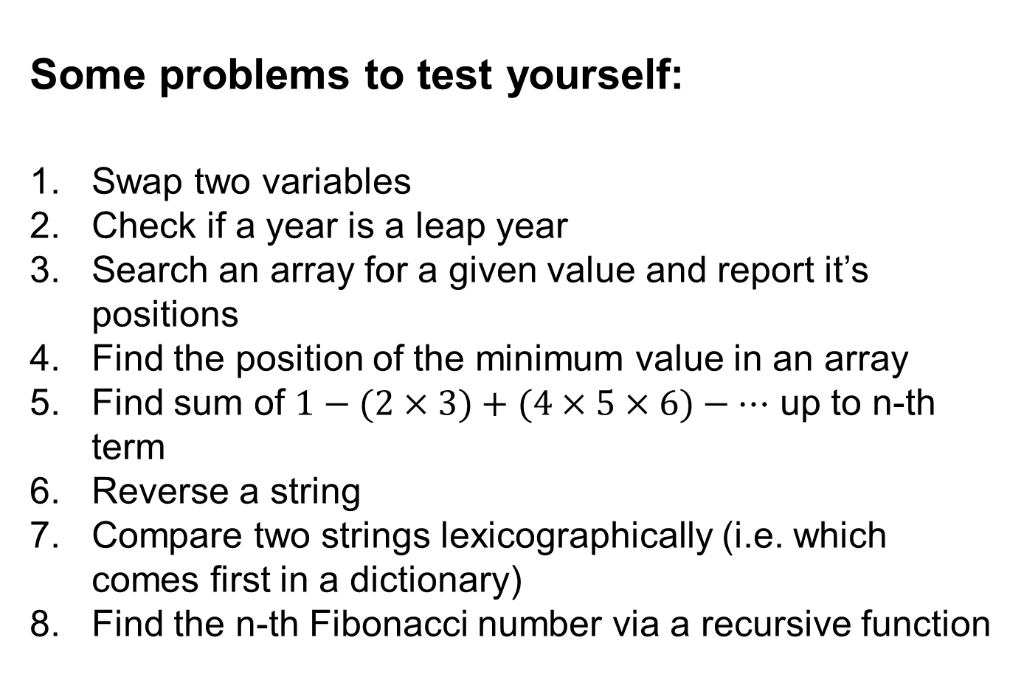
Some problems to test yourself:
Swap two variables
Check if a year is a leap year
Search an array for a given value and report it’s positions
Find the position of the minimum value in an array
Find sum of $1−(2×3)+(4×5×6)−…$ up to n-th term
Reverse a string
Compare two strings lexicographically (i.e. which comes first in a dictionary)
Find the n-th Fibonacci number via a recursive function

Slide 8
Now we’ll solve a very easy problem:
Watermelon (link)

Slide 9
Results when a code is run
Result | Meaning
Accepted | Correct Code
Wrong Answer | Solution is wrong, or there’s a bug
Compilation Error | Code has syntax errors
Time Limit Exceeded | Solution is too slow
Memory Limit Exceeded | Solution uses too much memory
Runtime Error | Array access out of bounds or division by 0

Slide 10
Book Resources: (Not mandatory, but really helpful)
Guide to Competitive Programming – Laaksonen (Best)
*Competitive Programmer’s Handbook – Laaksonen
প্রোগ্রামিং কনটেস্ট ডেটা স্ট্রাকচার ও অ্যালগরিদম – মাহবুবুল হাসান
*Dawn of Programming Contest - মাহবুবুল হাসান
Competitive Programming 3 – Halim (bad)
* Short version

Slide 11
Internet Resources:
শাফায়েতের ব্লগ (Bangla Blog)
BACS youtube channel (Bangla Videos)
CP algorithms site (Algorithm Codes in C++)
Geeks For Geeks site (Articles in many topics)
Topcoder tutorials (Articles in many topics)
Codeforces Blogs (Disorganized but has good articles)

Slide 12
Online Judges:
Codeforces (best)
AtCoder (good)
lightOJ (good)
CSES (good)
Codechef (average)
Kattis (average)
Toph (average)
SPOJ (bad)
UVA (bad)
ICPCLive (bad)
Timus (hard)
HDU (hard)

Slide 13
How to Practice?
Solve from Codeforces, filtered by rating.
Solve from LightOJ
If stuck, lookup solution or ask for help
Take part in weekly contests
In particular, to ask me for help, use slack

Slide 14
Some advice for beginners:
Include all libraries
Make I/O fast
Remember Overflow (long integer)
Floating Point is inaccurate
Test code in corner cases

